Slide 1
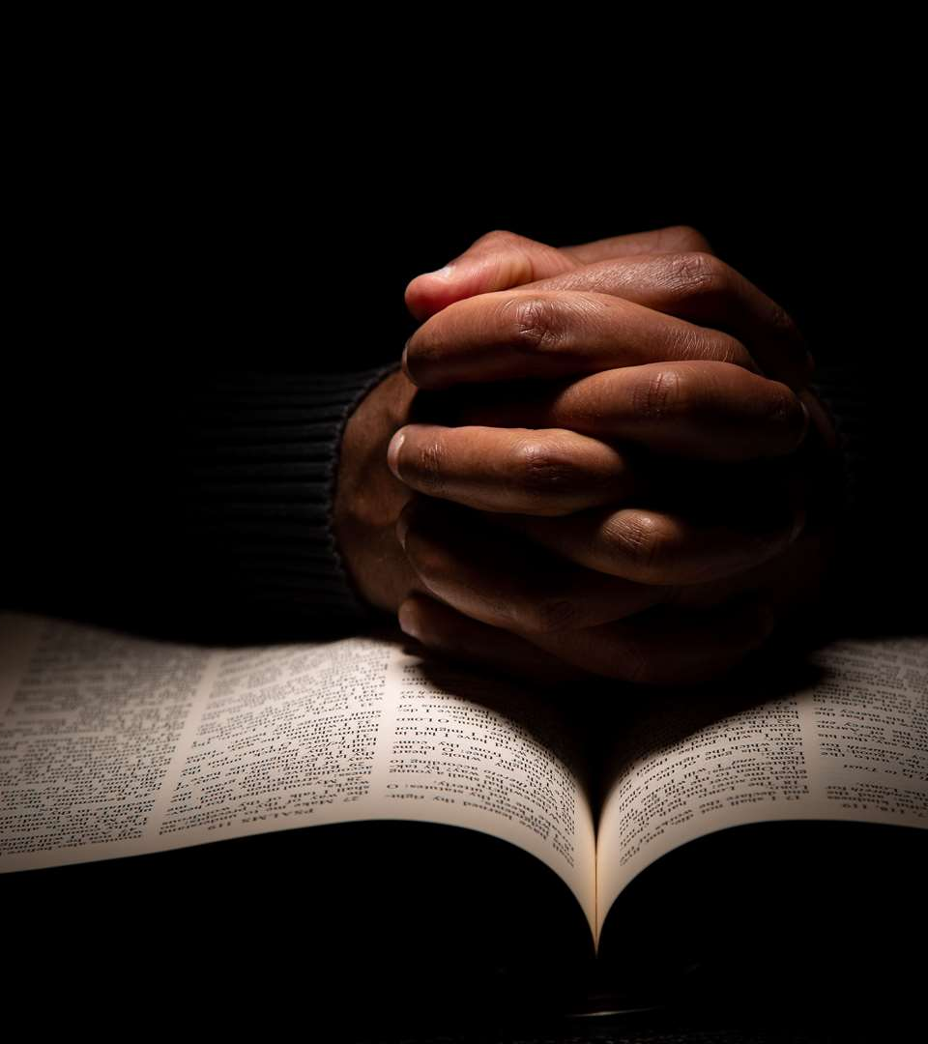
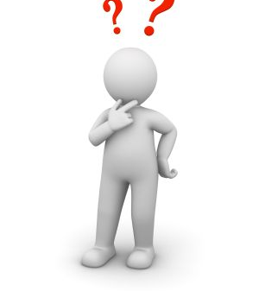
BUILDING THE BODY OF CHRIST

Slide 2
OBEY GOD
Jerimiah 11:7,8 :7 For I earnestly protested unto your fathers in the day that I brought them up out of the land of Egypt, even unto this day, rising early and protesting, saying, Obey my voice.
:8 Yet they obeyed not, nor inclined their ear, but walked every one in the imagination of their evil heart: therefore I will bring upon them all the words of this covenant, which I commanded them to do; but they did them not. KJV

Slide 3
Jerimiah 18:8-12 :8 If that nation, against whom I have pronounced, turn from their evil , I will repent of the evil that I thought to do unto them.
:9 And at what instant I shall speak concerning a nation, and concerning a kingdom, to build and to plant it;
:10 If it do evil in my sight, that it obey not my voice, then I will repent of the good, wherewith I said I would benefit them.

Slide 4
Malachi 1:6-8 :6,7 :8 And if ye offer the blind for sacrifice, is it not evil ? and if ye offer the lame and sick, is it not evil ? offer it now unto thy governor; will he be pleased with thee, or accept thy person? saith the LORD of hosts. KJV

Slide 5
TEACH THEM
Exodus 18:19-23 :19 Hearken now unto my voice, I will give thee counsel, and God shall be with thee: Be thou for the people to Godward, that thou mayest bring the causes unto God:
:20 And thou shalt teach them ordinances and laws, and shalt shew them the way wherein they must walk, and the work that they must do. KJV

Slide 6
Deuteronomy 6:7 And thou shalt teach them diligently unto thy children, and shalt talk of them when thou sittest in thine house, and when thou walkest by the way, and when thou liest down, and when thou risest up. KJV
11:19 And ye shall teach them your children, speaking of them when thou sittest in thine house, and when thou walkest by the way, when thou liest down, and when thou risest up. KJV

Slide 7
TO TEACH
Matthew 5:19-20 :19 Whosoever therefore shall break one of these least commandments, and shall teach men so, he shall be called the least in the kingdom of heaven: but whosoever shall do and teach them , the same shall be called great in the kingdom of heaven. KJV
Mark 6:34 And Jesus, when he came out, saw much people, and was moved with compassion toward them, because they were as sheep not having a shepherd: and he began to teach them many things.

Slide 8
SEEK Ye First
Matthew 6:33 But seek ye first the kingdom of God, and his righteousness; and all these things shall be added unto you. KJV
7:2-8 :7 Ask, and it shall be given you; seek, and ye shall find; knock, and it shall be opened unto you:
:8 For every one that asketh receiveth; and he that seeketh findeth; and to him that knocketh it shall be opened. KJV

Slide 9
Matthew 16:18,19 :18 And I say also unto thee, That thou art Peter, and upon this rock I WILL BUILD MY CHURCH; and the gates of hell shall not prevail against it.
:19 And I will give unto thee the keys of the kingdom of heaven: and whatsoever thou shalt bind on earth shall be bound in heaven: and whatsoever thou shalt loose on earth shall be loosed in heaven. KJV

Slide 10
THE SUPPER
Luke 22:16-20 :16 For I say unto you, I will not any more eat thereof, until it be fulfilled in the kingdom of God.
:17 And he took the cup, and gave thanks, and said, Take this, and divide it among yourselves:
:18 For I say unto you, I will not drink of the fruit of the vine, until the kingdom of God shall come.
:19 And he took bread, and gave thanks, and brake it, and gave unto them, saying, This is my body which is given for you: this do in remembrance of me.
:20 Likewise also the cup after supper , saying, This cup is the new testament in my blood, which is shed for you.

Slide 11
THE PROMISE TO THE APOSTLES
Luke 24:44-49 :44 And he said unto them, These are the words which I spake unto you, while I was yet with you, that all things must be fulfilled, which were written in the law of Moses, and in the prophets, and in the psalms, concerning me.
:45 Then opened he their understanding, that they might understand the scriptures,
:46-49 And, behold, I send the promise of my Father upon you: but tarry ye in the city of Jerusalem, until ye be endued with power from on high.

Slide 12
THE PROMISE COMPLETED
Acts 2:46,47 :46 And they, continuing daily with one accord in the temple, and breaking bread from house to house, did eat their meat with gladness and singleness of heart,
:47 Praising God, and having favour with all the people. And the Lord added to the church daily such as should be saved. KJV

Slide 13
Paul Speaks Clearly of Church Pattern
Paul greets the Philippian Church, addressing all the members, the bishops and deacons.
Phil 1:1-6 :1 Paul and Timotheus, the servants of Jesus Christ, to all the saints in Christ Jesus which are at Philippi, with the bishops and deacons: KJV

Slide 14
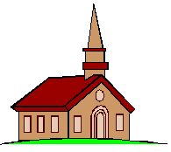
What is the Church?
ekklesia: “to call out of” … “the called out ones”
Body of the Saved
“Called out” of darkness
by God, by the gospel
1 Pet. 2:9-10;2 Thess. 2:14
The Redeemed
Mt. 16:18
An Assembly
-Israel, Acts 7:38
-Riot, Acts 19:32, 41
-Gov’t body, Acts 19:39
4

Slide 15

{
CHRIST
Baptized into Rom. 6:3-4
CHURCH (Universal) Heb. 12:23
{
Join Acts 9:26
CHURCH (Local) (elders, deacons, saints) Acts14:23;
Phil. 1:1
Local Church Acts 11:22
Local Church Acts 11:26
Churches of Christ
Rom. 16:16

Slide 16
Four ways by which Authority may be established:
  Direct Statement or Command (Precept)
  Approved Example (Example approved by an inspired man)
  Necessary Inference (A conclusion that is forced)
  The silence of the Scriptures

Slide 17
LIVELY STONES
1 Peter 2:1-5 :4 To whom coming, as unto a living stone, disallowed indeed of men, but chosen of God, and precious,
:5 Ye also, as lively stones, are built up a spiritual house, an holy priesthood, to offer up spiritual sacrifices, acceptable to God by Jesus Christ.

Slide 18
1 Peter 2:6,7 :6 Wherefore also it is contained in the scripture, Behold, I lay in Sion a chief corner stone, elect, precious: and he that believeth on him shall not be confounded.
:7 Unto you therefore which believe he is precious: but unto them which be disobedient, the stone which the builders disallowed, the same is made the head of the corner,

Slide 19
1 Peter 2:8,9 :8 And a stone of stumbling, and a rock of offence, even to them which stumble at the word, being disobedient: whereunto also they were appointed.
:9 But ye are a chosen generation, a royal priesthood, an holy nation, a peculiar people; that ye should shew forth the praises of him who hath called you out of darkness into his marvellous light:

Slide 20
THE PLAN OF SALVATION
Hear the gospel: John 5:24; Acts 15:7; Romans 10:17; Revelation 3:20
Believe: Mark 16:16; John 3:16-18; John 11:25-26; Acts 16:31; Hebrews 11:6
Repent of your sins: Luke 13:3-5; Acts 2:38; Acts 17:30; 2 Corinthians 7:10; 2 Peter 3:9
Confess Christ: Matthew 10:32; Romans 10:9-10; 2 Timothy 2:19; 1 John 1:9
Baptism for the remission of sins: Matthew 28:18-20; Mark 16:16; John 3:5; Acts 2:38-41; Acts 22:16; Romans 6:3-5; Galatians 3:26-27; Titus 3:5-7; 1 Peter 3:18-22; 1 John 5:5-12

Slide 21
LIVE FAITHFULLY
1 Cor 4:1,2 :1 Let a man so account of us, as of the ministers of Christ, and stewards of the mysteries of God.
:2 Moreover it is required in stewards, that a man be found faithful . KJV
4:17 For this cause have I sent unto you Timotheus, who is my beloved son, and faithful in the Lord, who shall bring you into remembrance of my ways which be in Christ, as I teach every where in every church.

